Slide 1




VLSI Design flow for TSMC 28nm
Project numbers: 3172+ 3135
Student names:
Ahmad Foqara + Lama Garra
Adan Mohsen + Leena Wattad
Mentor name: Zvi Webb
Project location: Tel Aviv University
Mentor signature

Slide 2

VLSI Design flow for TSMC 28nm
Project Overview:
A Brief Introduction to the Chip Design Flow
This project aims to develop a comprehensive guide detailing the complete chip design process using TSMC 28nm technology.
It covers all key stages of the VLSI design flow, including RTL development, synthesis, physical design, verification, and GDSII generation, providing a structured framework for efficient, precise, and industry-aligned chip fabrication.

Slide 3



VLSI Design flow for TSMC 28nm
Growing demand for advanced VLSI chip design.
Bridging gaps between academic knowledge and industry practices.
Need for standardized workflows to improve efficiency
Enhances practical and theoretical VLSI skills.
Reduces design errors and development time.
Aligns academic learning with industry needs.
Comprehensive guide from RTL to GDSII.
Hands-on resources: chip designs & scripts.
Promotes best practices in VLSI design.
Supplementary Material for VLSI Courses.
Motivation
Importance
Contribution
.

Slide 4




VLSI Design flow for TSMC 28nm
Methodes of implantation:
Review of courses relevant to the project
Review of the material and practice on a pre-prepared flow
Learning Unix
Coding in System Verilog
Synopsys tools:
Fusion Compiler
StarRC
ICV
Formality.
PrimeTime
Synopsys Euclide

Slide 5
VLSI Design flow for TSMC 28nm
Project requirements:
Access to TSMC28mmwave technologies
Access to the open source RISCV
Project deliverables:
Detailed Guide: Includes processes, scripts, and examples for the full implementation of the Design Flow.
Sample Exercise:
A practical exercise will be developed to demonstrate all stages of the process, from RTL to GDSII.
Sample GDSII: Generation of a sample chip design to serve as an application model.

Slide 6
VLSI Design flow for TSMC 28nm
VLSI Design flow for TSMC 28nm
Updated Block Diagram:
Verification
Synthesis
Floor Planning and Placement
CTS and Routing
System Verilog, Euclide
Fusion Compiler

Slide 7
VLSI Design flow for TSMC 28nm
Formality
Star RC
Prime Time
Gate Level Simulation
Final STA testcase and scripts
Final LVS/DRC testcase and scripts
Sign off flow

Slide 8
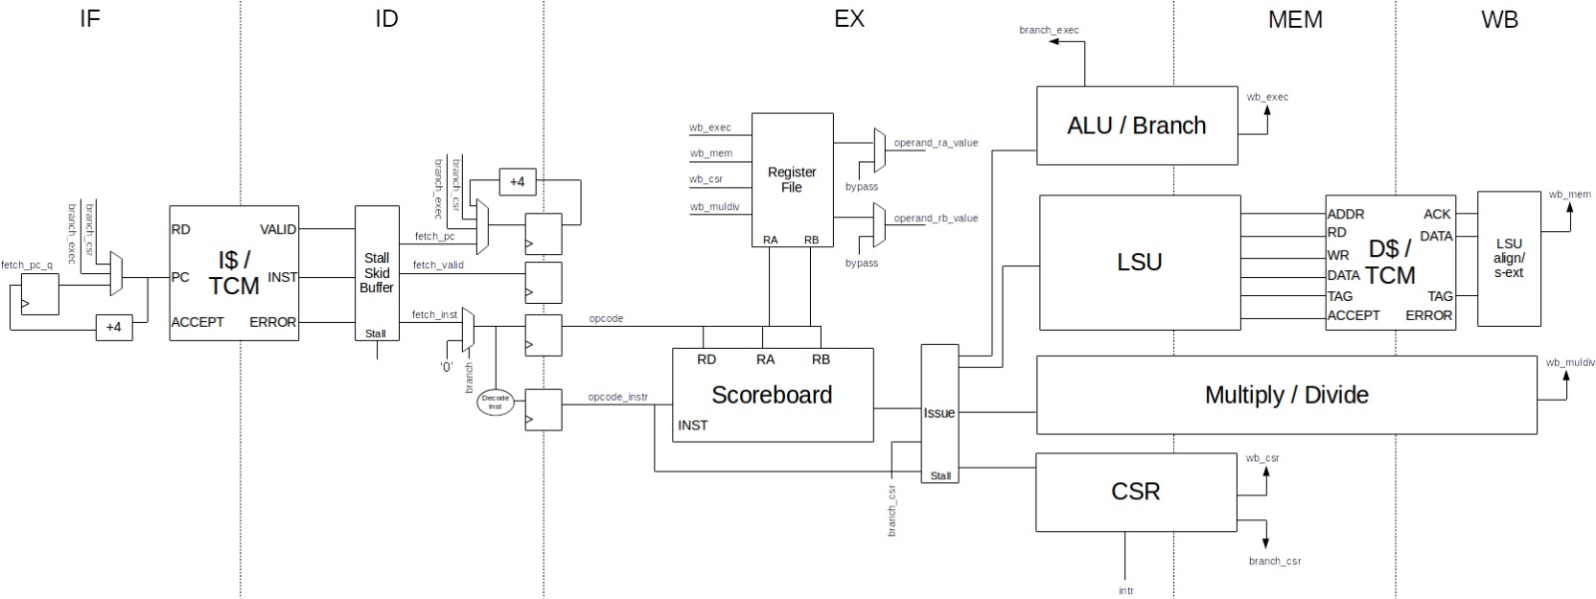
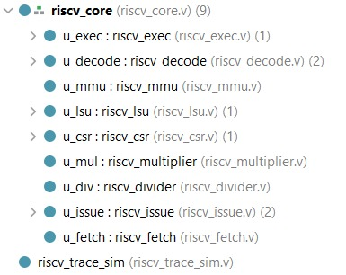
VLSI Design flow for TSMC 28nm
Design architecture & RTL
The high-level architecture is systematically translated into RTL Verilog modules,
where each block in the pipeline is implemented as a corresponding hardware description module.

Slide 9







VLSI Design flow for TSMC 28nm
Project Deliverables Achieved So Far:
Verification
Understand the Design
Define the Verification Plan
Develop the Testbench
Define Coverage Points
Final Sign-Off
Debug and Iterate
Run Simulations

Slide 10
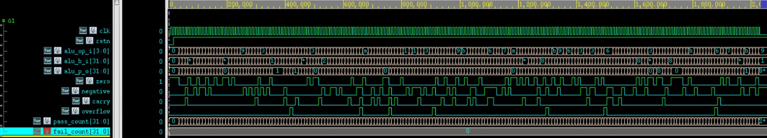
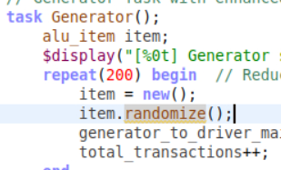
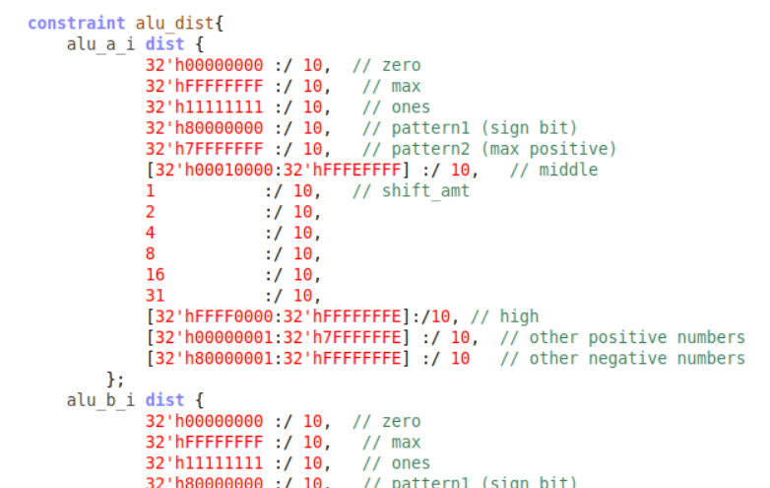
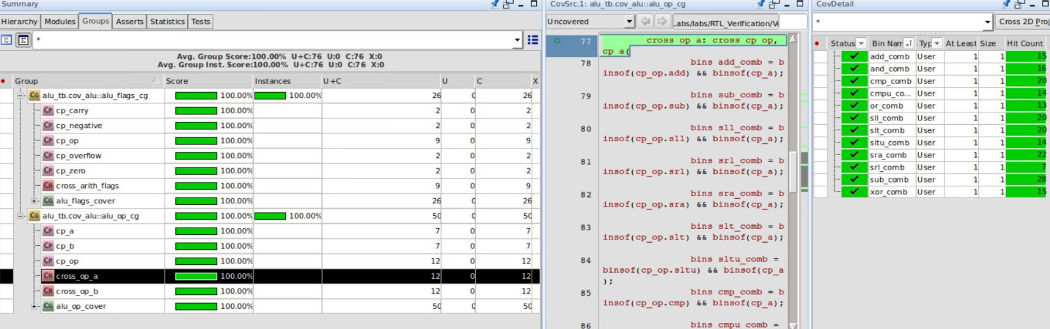
VLSI Design flow for TSMC 28nm
Verification Results
Basic test + random test + constrains + define coverage points + cross coverage + flags + cross flags
=
~100% + good structure for integrations

Slide 11
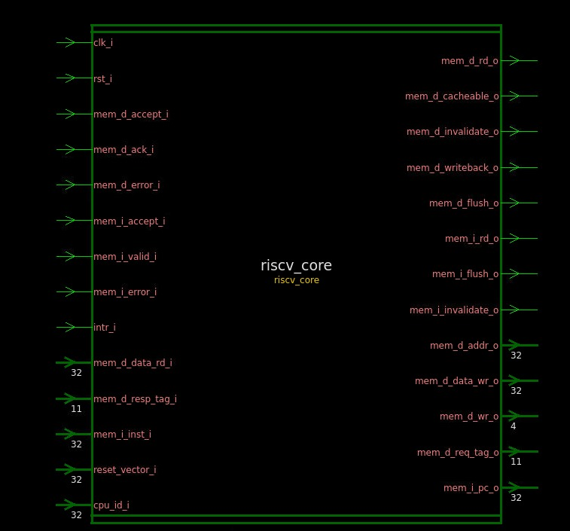
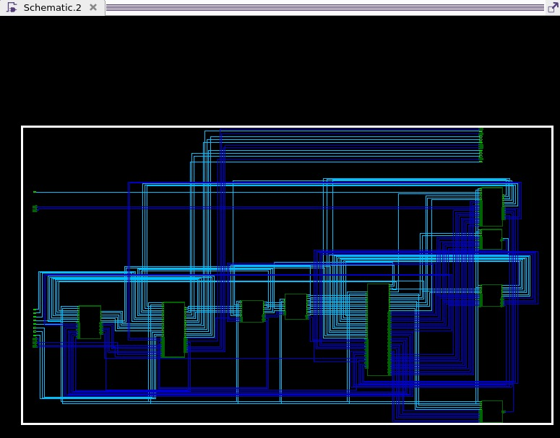
VLSI Design flow for TSMC 28nm
Reading RTL
Creating the Design Library
Saving the Library
Reading the RTL
Working with Blocks
Elaboration
Setting the Top Module

Slide 12
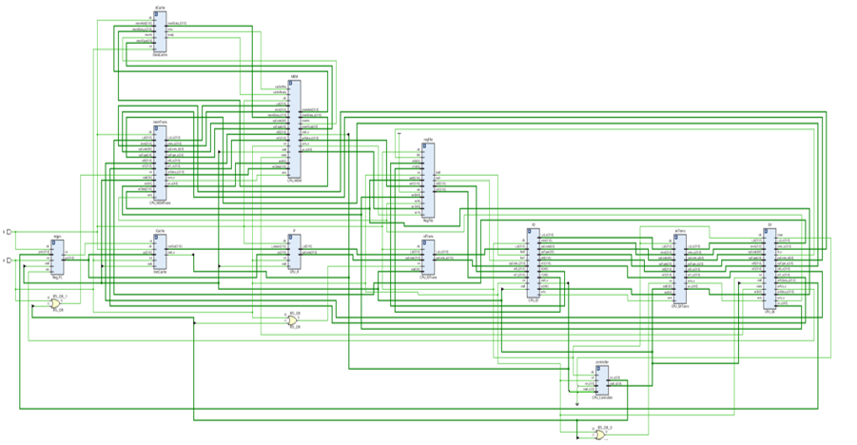
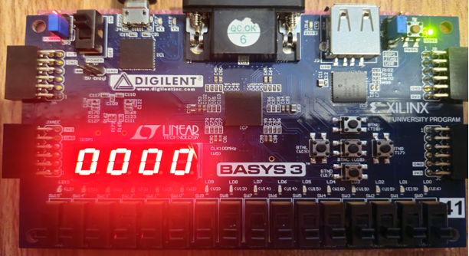
VLSI Design flow for TSMC 28nm
FPGA Prototype – RISC-V CPU
The verified RTL design was successfully implemented on a Xilinx Basys3 FPGA.
Demonstrated correct execution of compiled C programs.
Validated the instruction set functionality in real hardware.
Showcased versatility of the RISC-V CPU for both academic and industrial applications.

Slide 13
VLSI Design flow for TSMC 28nm
Synthesis
Syntax Analysis
Library Definition
Elaboration and Binding
Pre-mapping Optimization
Constraint Definition
Technology Mapping
Post-mapping Optimization
Report and Export
GOALS:
✔Ensuring compliance with timing, power, and area requirements ✔ Reducing manual effort while maintaining design quality and scalability

Slide 14
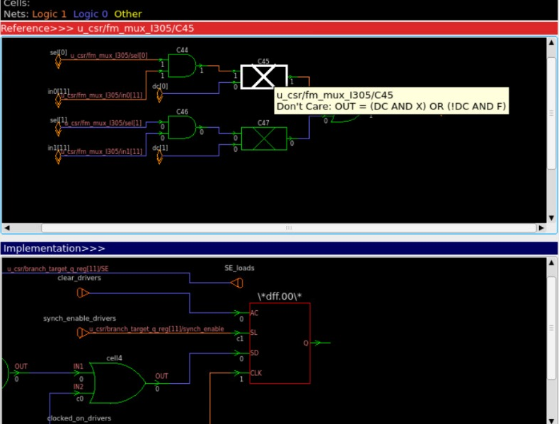
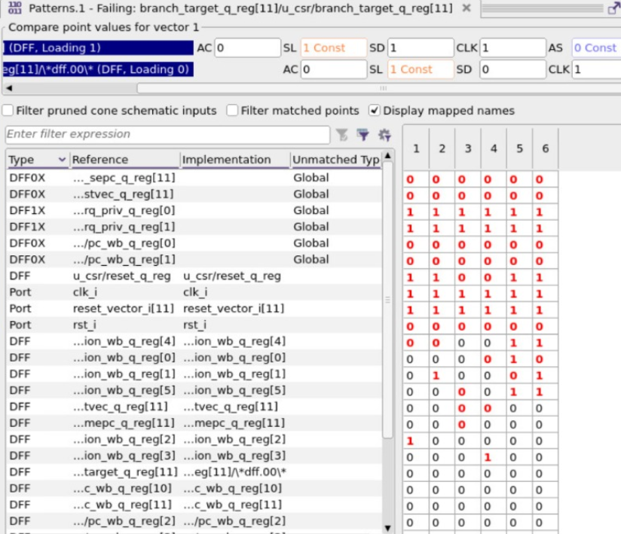
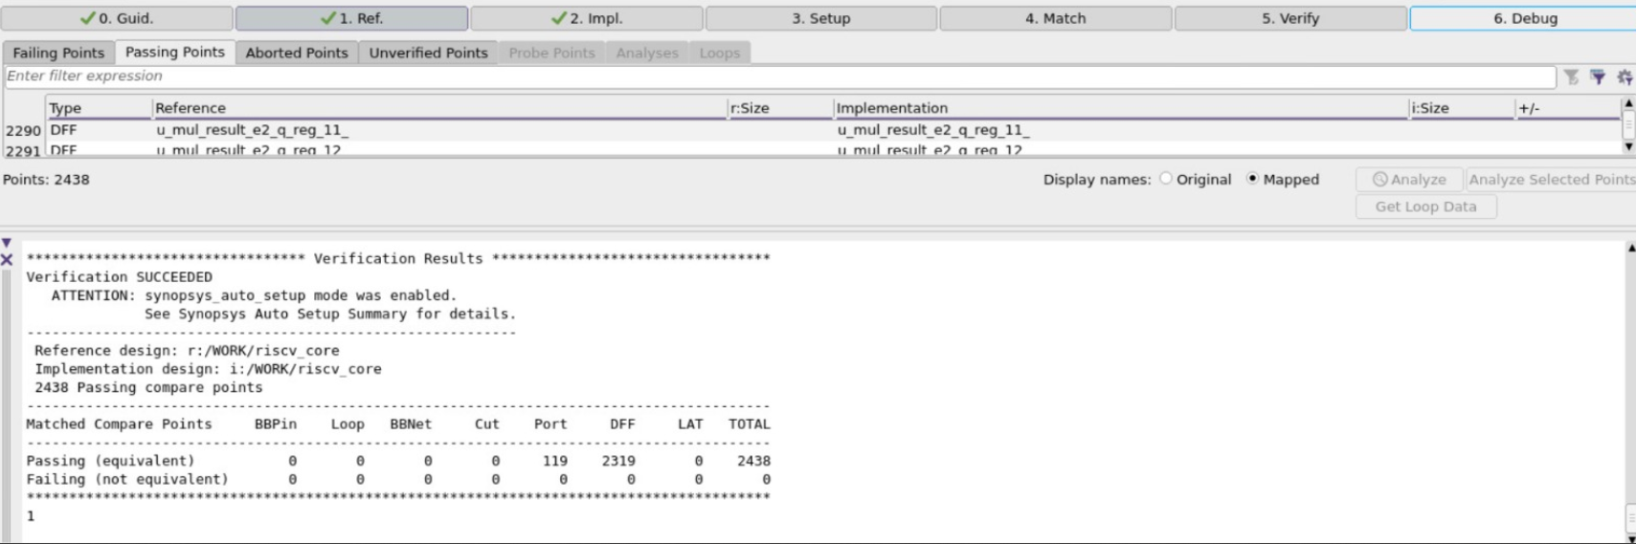
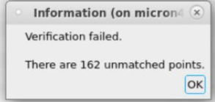
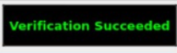
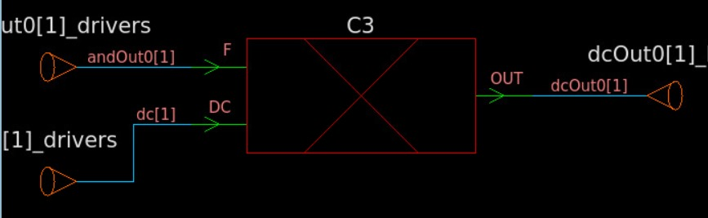
VLSI Design flow for TSMC 28nm
Synopsys Formality(LEC)
Logical Equivalence Checking

Slide 15

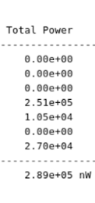
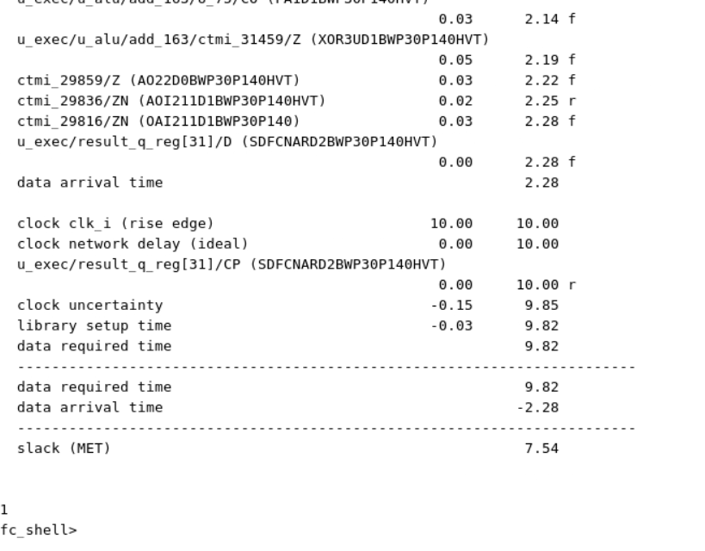

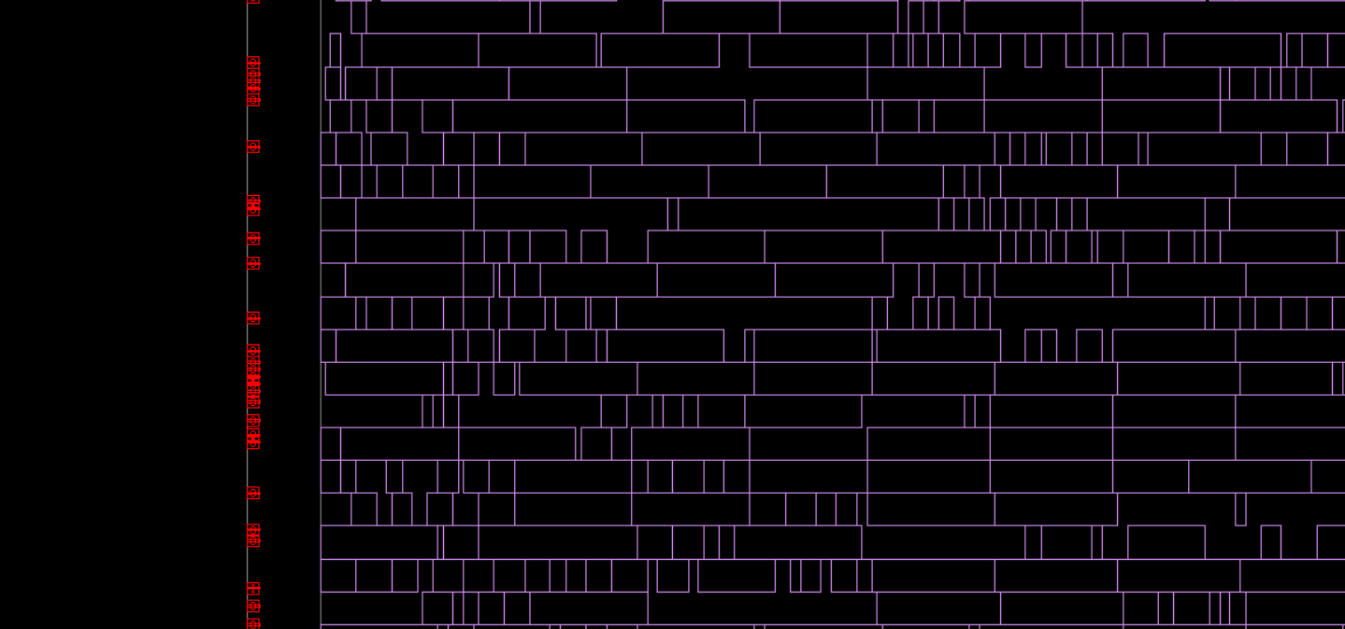
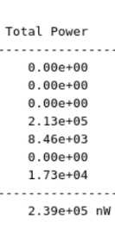
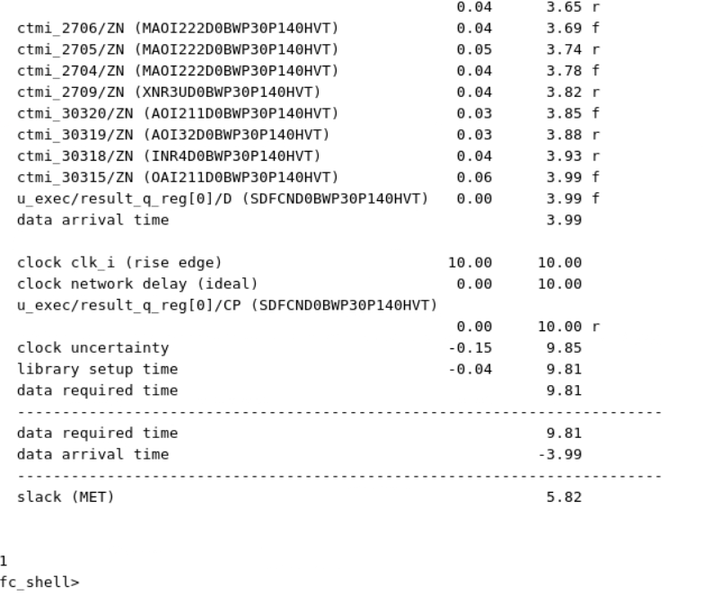

VLSI Design flow for TSMC 28nm
Floorplanning & Placement:
Technology: TSMC 28nm.
Tools Used: Synopsys Fusion Compiler.
Floorplanning
Approach: Defined core utilization (70%), optimized macro placement, and integrated efficient power distribution strategies.
Placement
Approach: Utilized congestion-aware placement techniques, multi-corner multi-mode (MCMM) analysis, and timing-driven optimization to achieve design goals.

Slide 16

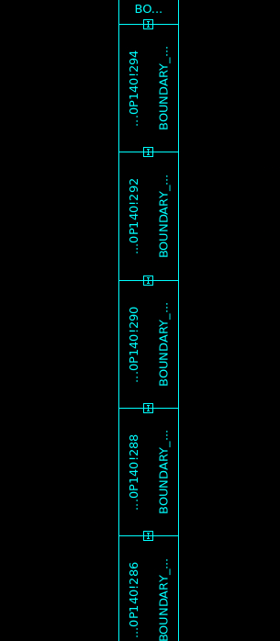
VLSI Design flow for TSMC 28nm
Boundary
Boundary cells are physical-only cells placed at the edges of standard cell rows or block boundaries.
They protect edge transistors from manufacturing damage during fabrication .
They ensure continuity and power rails up to the block edges.
They avoid DRC violations by properly capping the layout at the boundaries.
Boundary cells = safe row edges + DRC clean.

Slide 17
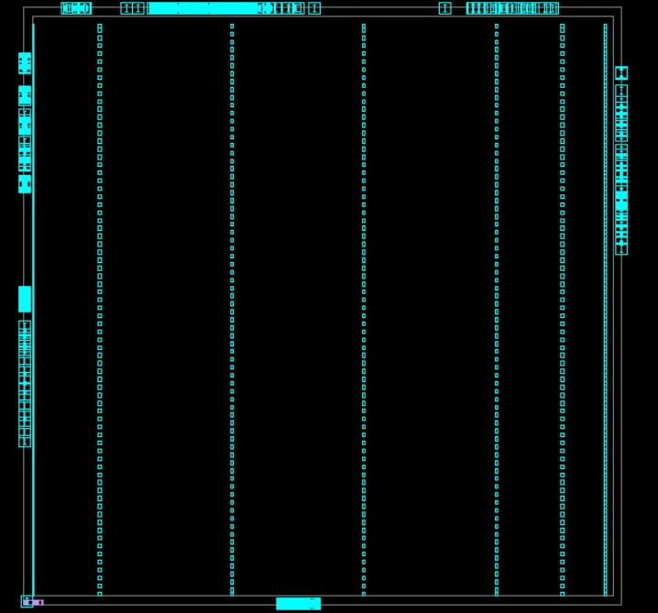
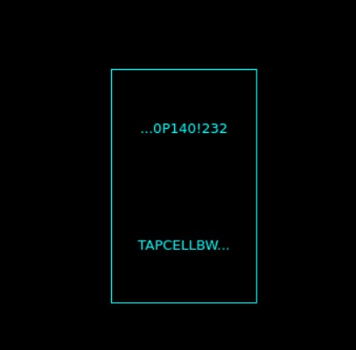
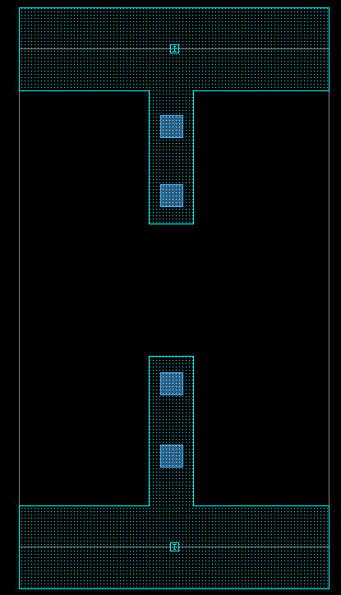
VLSI Design flow for TSMC 28nm
Tap cells
Tap cells are special physical-only cells inserted in the layout to connect the substrate and wells to power and ground, preventing latch-up and ensuring stable transistor operation.
Without tap cells, floating wells could cause latch-up, leakage, or unstable transistor behavior — tap cells ensure reliable and safe chip operation Tap cells = reliability + protection against latch-up.

Slide 18
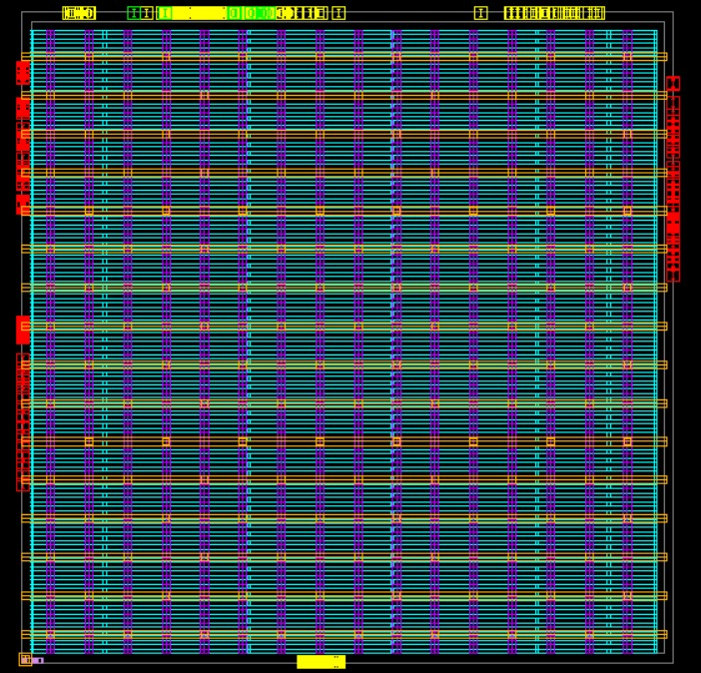
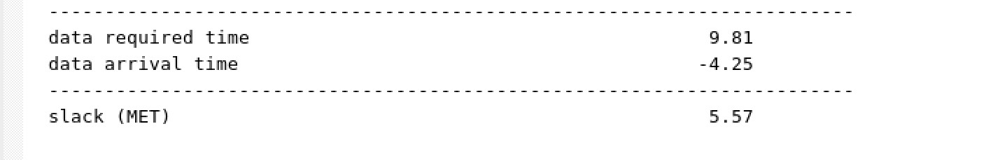
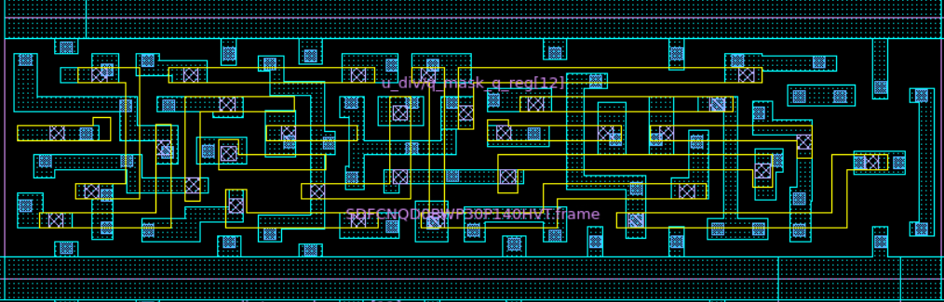
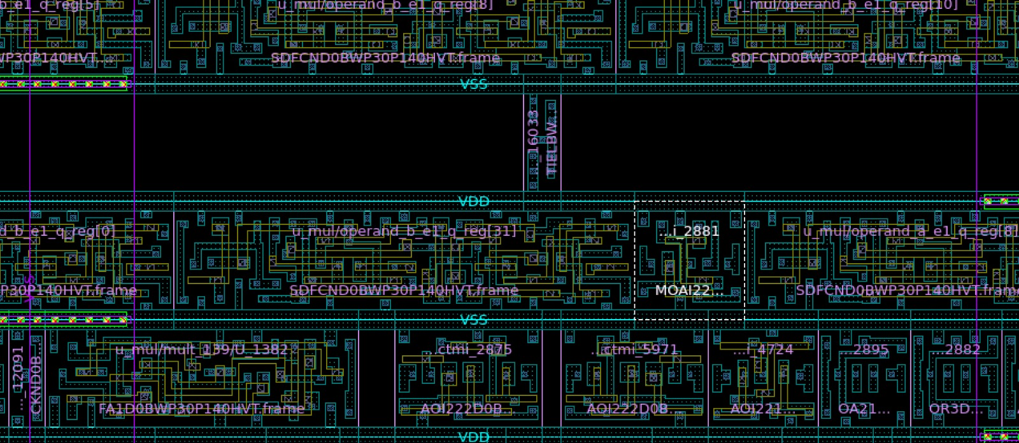
VLSI Design flow for TSMC 28nm
Power Grid
Before adding the power optimization:
After adding the power optimization:

Slide 19
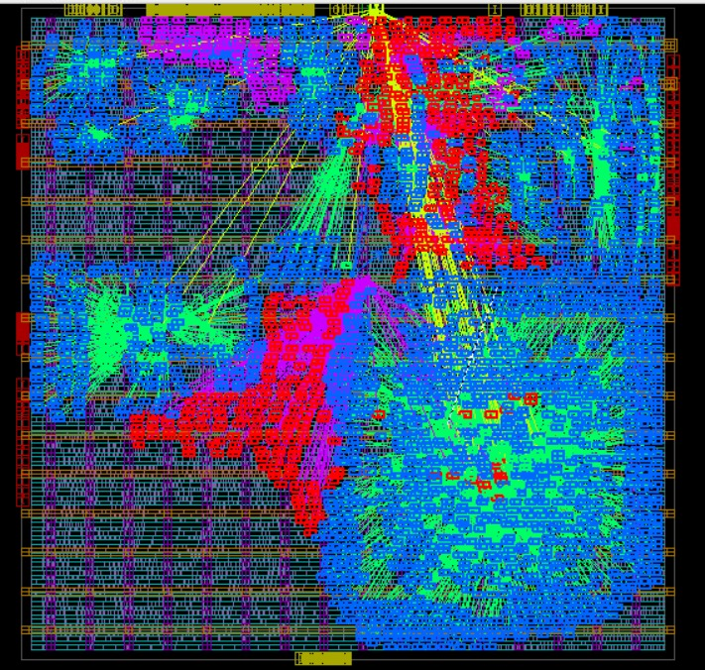




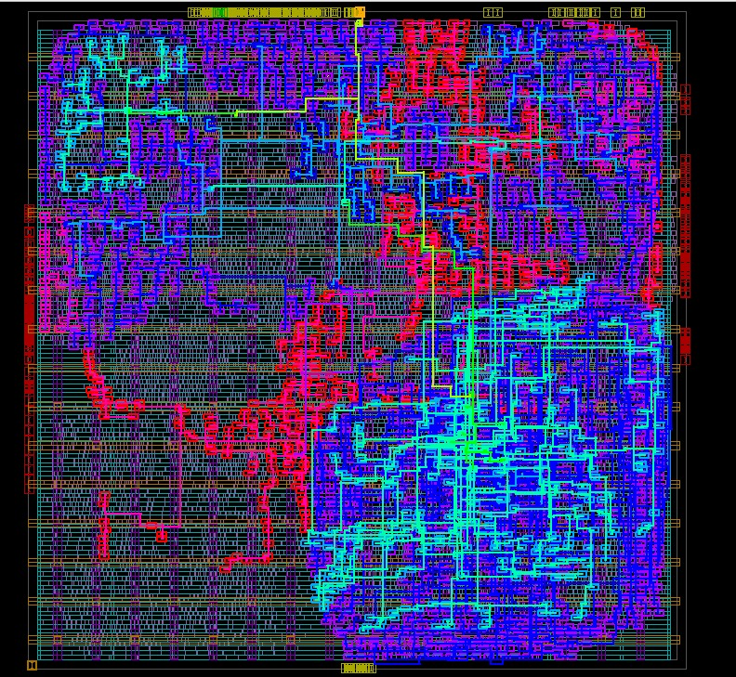
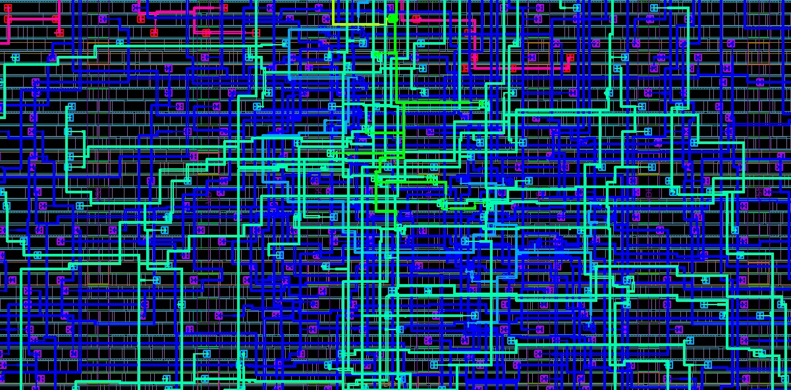
VLSI Design flow for TSMC 28nm
Optimizing Clock Distribution with CTS
Minimize Clock Skew: → Uniform clock delivery
Reduce Insertion Delay:→ Faster clock propagation
Enhance Power Efficiency:→ Lower power consumption
Improve Signal Integrity: → Noise reduction & signal reliability

Slide 20
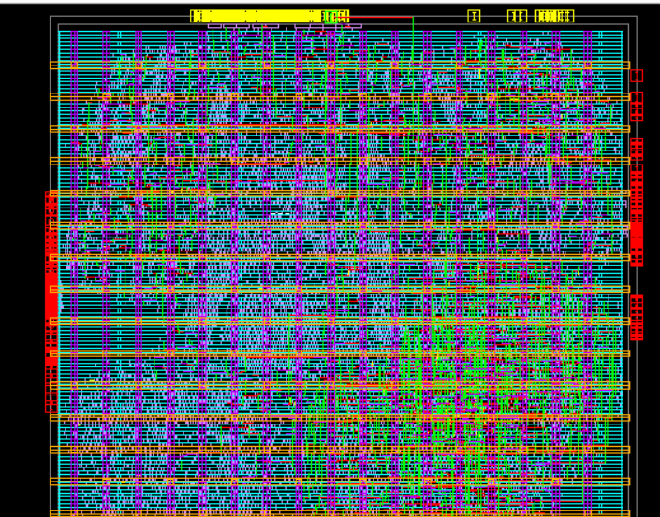
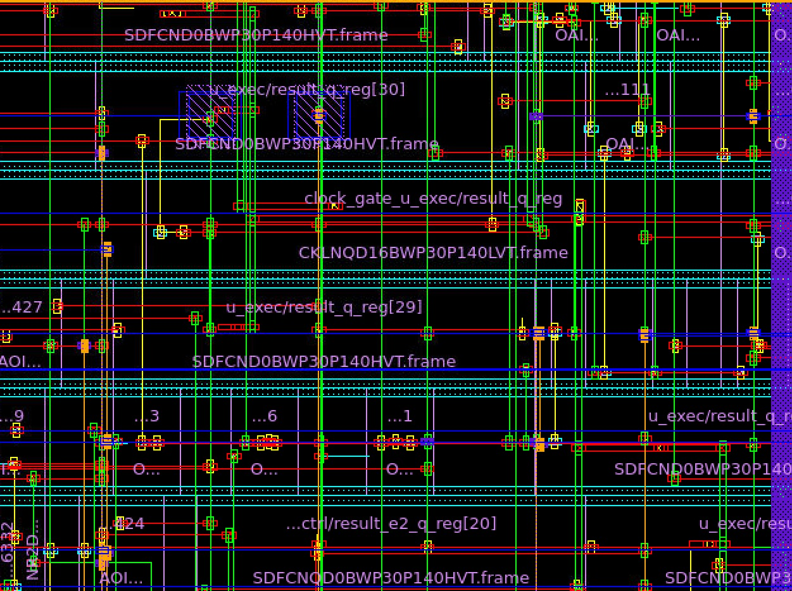
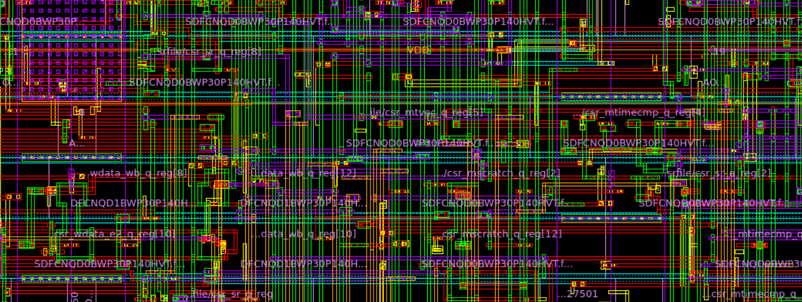

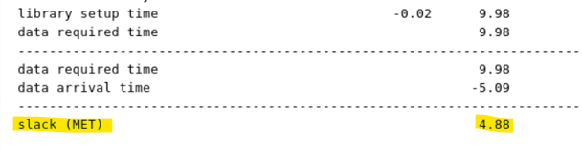
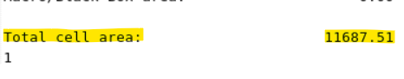
VLSI Design flow for TSMC 28nm
Routing in VLSI Design: Ensuring Optimal Signal Flow
Before Routing
After Routing
Following the CTS and Routing phases, the timing performance has significantly improved, as reflected in the updated slack and reduced data arrival time.

Slide 21
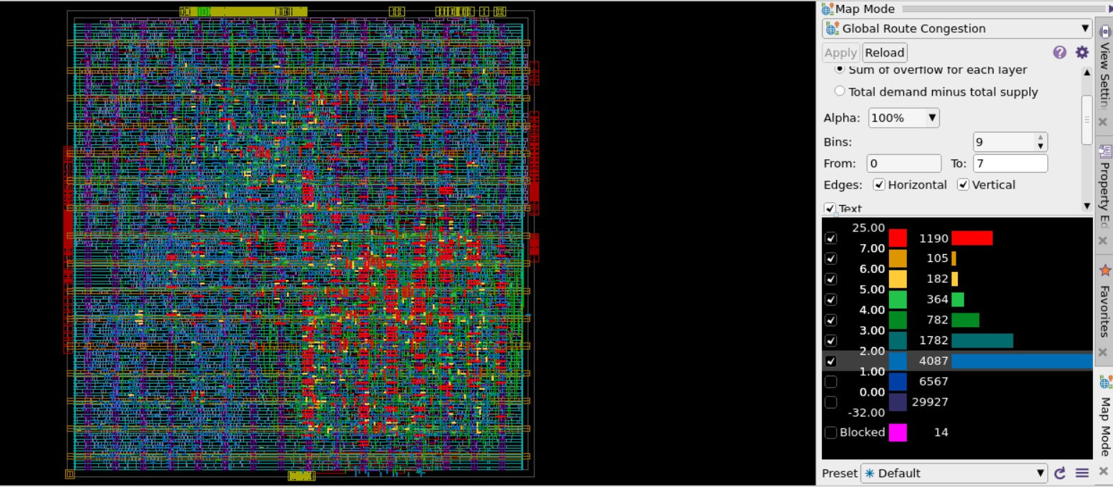
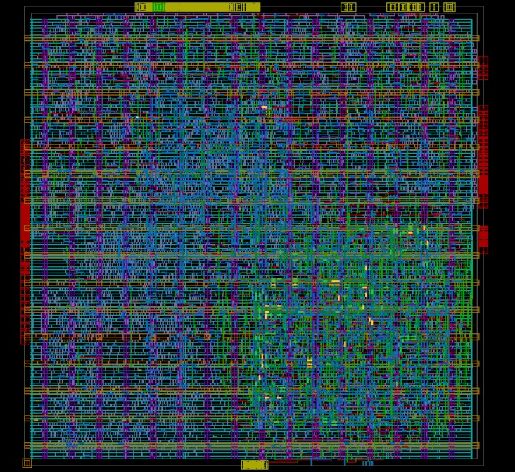
VLSI Design flow for TSMC 28nm
Routing Congestion:
Think of it like traffic: too many cars (nets) on too few roads (routing tracks).
Routing congestion happens when the demand for routing tracks (wires) in a region of the chip is greater than the available routing resources.
Routing

Slide 22
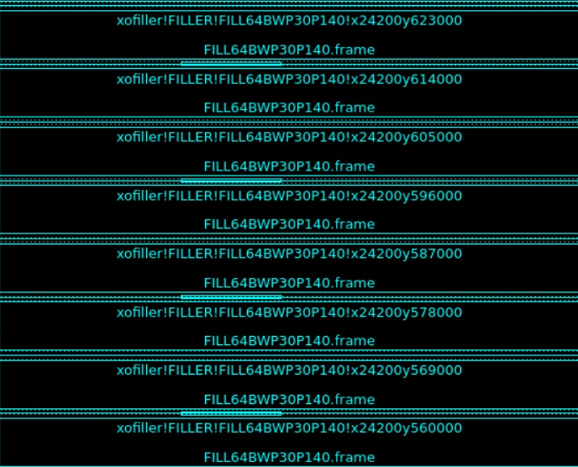
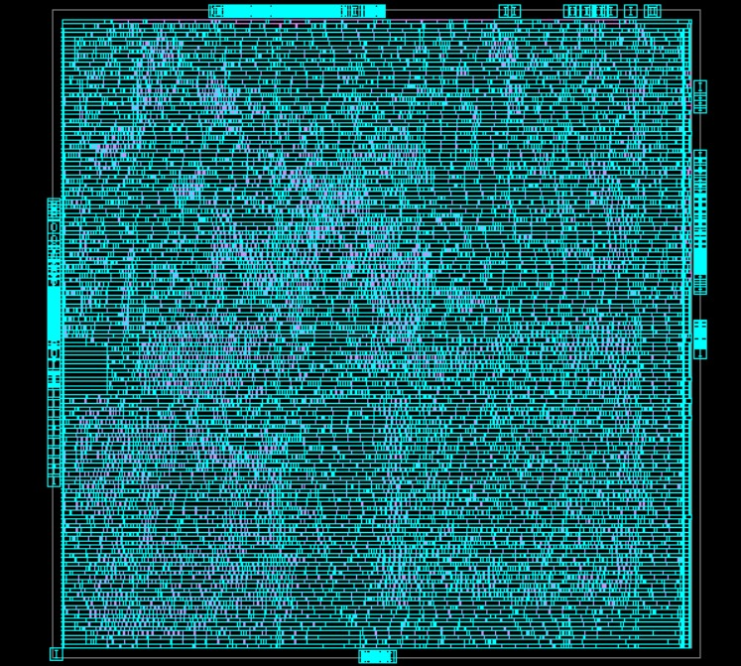
VLSI Design flow for TSMC 28nm
Filler cells
Filler = fill gaps & connect rails.
Filler cells are physical-only standard cells (no logic) inserted into the empty spaces (gaps) between placed standard cells in the layout.
Without filler cells, gaps in the layout could break VDD/VSS rails, wells, or cause DRC violations.

Slide 23
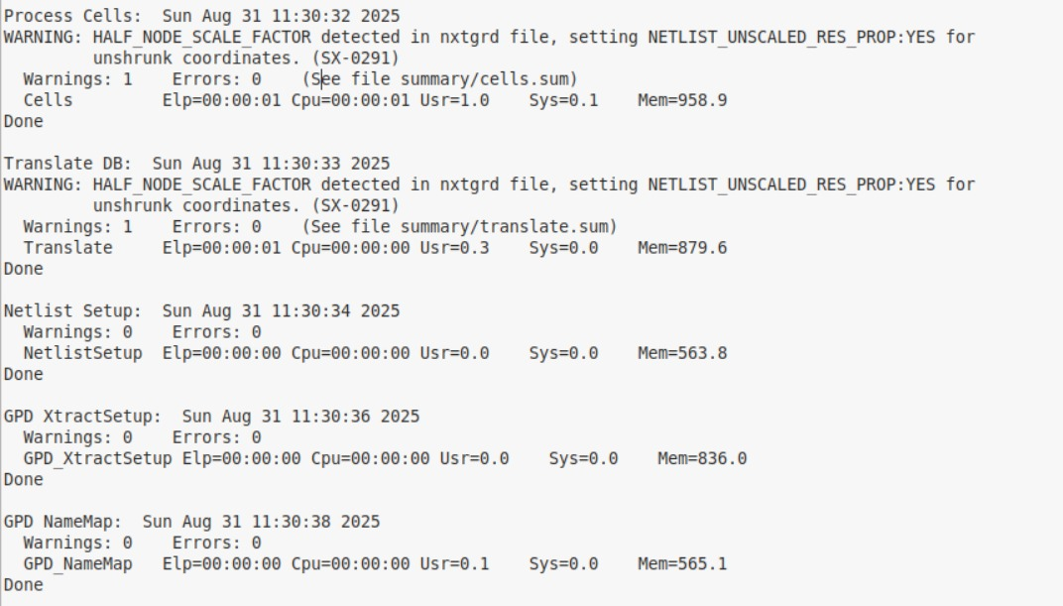
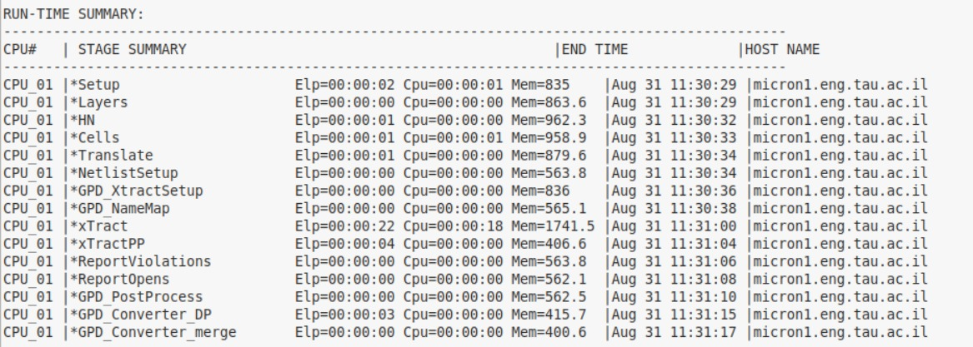
VLSI Design flow for TSMC 28nm
Parasitic Extraction (RC) – Synopsys Star-RC
The extraction flow completed successfully with no errors.
Metric | Value
Resistors extracted | 1,136,323 → reduced to 109,955 (~90%)
Capacitors extracted | 878,486 → reduced to 137,372
Coupling capacitors | 18,044 (~13% of total caps)
Nodes | 1,037,265 → reduced to 119,328 (~88%)
Runtime (overall) | 43 sec
Peak memory | 1.74 GB
SPEF output | Generated successfully

Slide 24
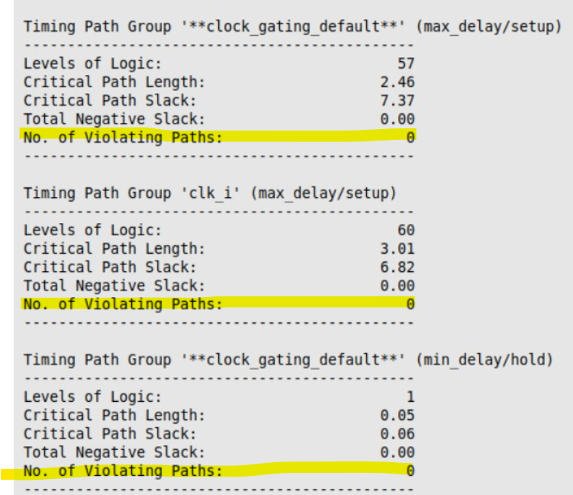
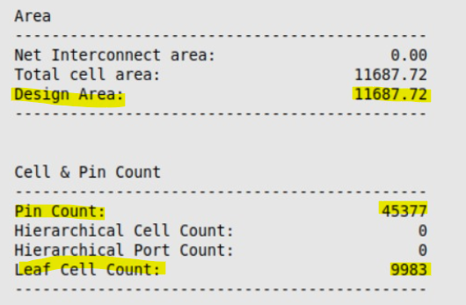
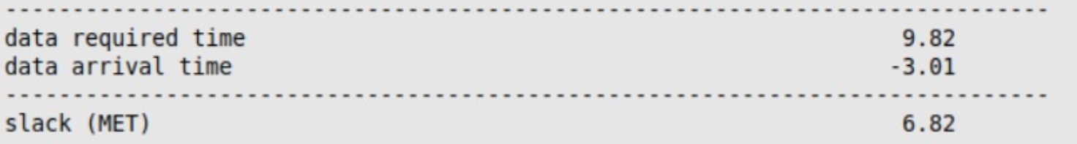
VLSI Design flow for TSMC 28nm
Prime Time
Static Timing Analysis (STA) was successfully performed using Synopsys PrimeTime with extracted parasitics (SPEF).
Results Summary:
Timing sign-off completed
Positive slack (setup & hold)
Zero violations
Balanced clock & skew
Design area and cell count consistent with expectations

Slide 25
VLSI Design flow for TSMC 28nm
Signoff
What is it?
The final stage in the VLSI design flow that ensures the chip is ready for tapeout and manufacturing.
Why is it needed?
Guarantees compliance with foundry manufacturing rules (PDK).
Confirms consistency between schematic and physical layout.
Prevents critical errors that could lead to chip failure.
Main Objectives:
✔️ DRC – Design Rule Check.
✔️ Timing Signoff – Static timing.
✔️ Metal Fill – Meet density requirements.
Outcome:
A “clean” design fully prepared for GDSII tapeout and fabrication.

Slide 26
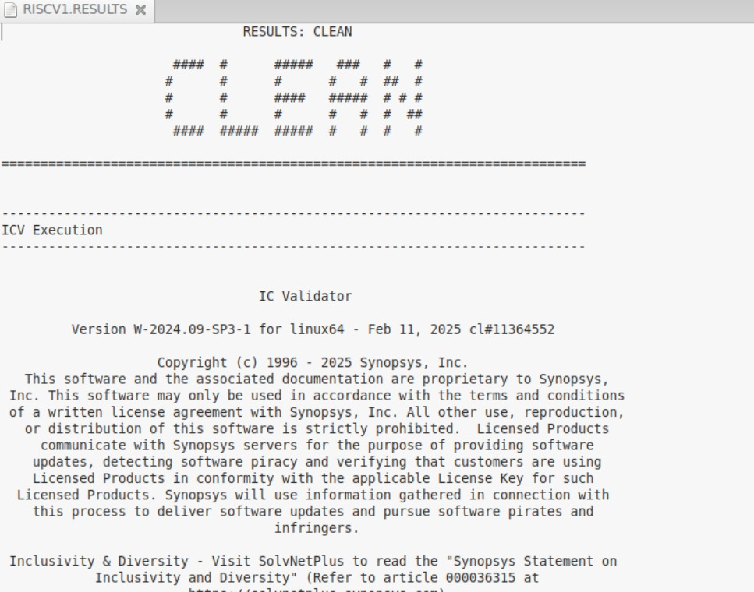
VLSI Design flow for TSMC 28nm
Signoff : Design Rule Check (DRC) Results
Goal: Ensure layout complies with foundry design rules (TSMC 28nm)
Process:
Run ICV signoff checks.
Validate spacing, width, density, and manufacturing constraints.
Outcome:
✅ No violations detected – Design is CLEAN.Fully compliant with TSMC 28nm rules, ready for next signoff steps.

Slide 27
VLSI Design flow for TSMC 28nm
Signoff : Metal Fill Results
Goal:
Ensure metal density meets foundry requirements (TSMC 28nm) for manufacturability and uniform CMP.
Process:
Run pre-fill density check.Insert dummy metal shapes on layers (M2–M6).
Run post-fill density check and validate results.
Outcome:
✅ Density targets achieved — Design meets TSMC 28nm metal density rules. Layout is clean.
Notes:
במהלך ייצור נוצרות לפעמים אי־אחידות בצפיפות בשכבות המתכת כלומר יש אזורים בצ’יפ עם הרבה חיווטים ואזורים כמעט ריקים. כדי להבטיח איכות ייצור אחידה, יש דרישות מחייבות לצפיפות מינימלית ומקסימלית של מתכת בכל שכבה. כדי למנוע את זה, מכניסים Metal Fill – צורות קטנות של מתכת (כמו ריבועים או פסים) שמופזרים בצורה אוטומטית על פני השבב באזורים "ריקים".

Slide 28

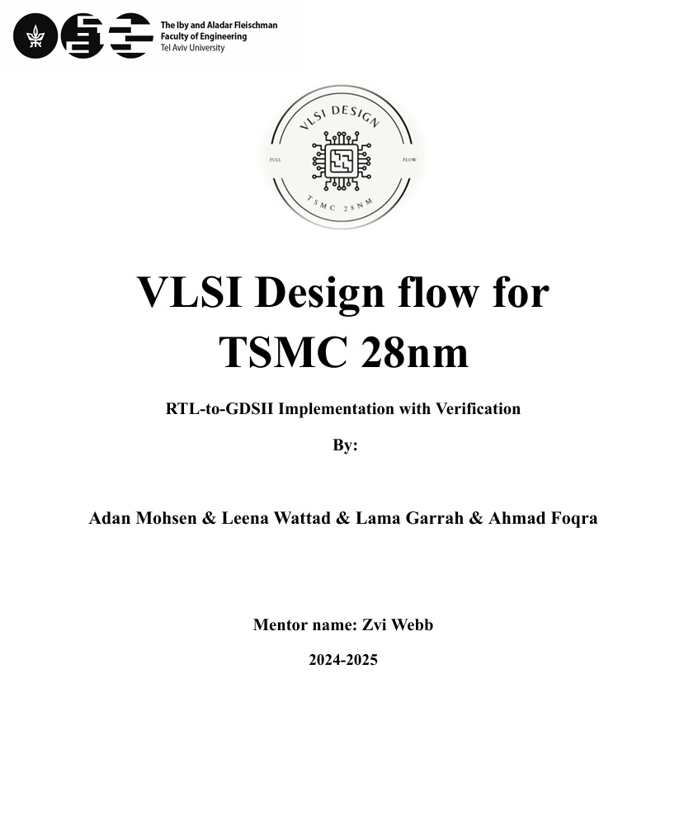

VLSI Design flow for TSMC 28nm
Final Results:
Metric | Achieved Result | Requirement | Status
Area | 11,687 μm² | ≤ 12,000 μm² | ✔ Met
Power | 259 μW | ≤ 300 μW | ✔ Met
Timing | +4.88 ns slack | ≥ 0 ns (positive) | ✔ Met
Coverage | ~100% functional | 100% expected | ✔ Met
Conclusion
All requirements were successfully met (area, power, timing, coverage).
Design is efficient, fully verified, and timing-clean.

